Slide 1
The Use of Generative AI (OpenAI AI) to generate time-series forecasts and estimates for defect detection
Megan Tan, Eric Zhang

Slide 2
AGENDA
Objective
Model
Data Metrics
Experiment
Discussion
Future Expansion
Summary
Citations

Slide 3
OBJECTIVE
To gauge how good generative AI is at estimating the amount of defects given software metrics by comparing OpenAI’s responses to a trained model

Slide 4
Model details
Data Collection
Metrics and number of bugs from PROMISE Dataset
Limitation: Metrics contain OOP metrics, so prediction can only be done for OOP projects
Data Preprocessing
For OpenAI, Subset of data is taken due to API Token Limit
Data is standardized with StandardScalar
Model Training
RandomForestRegressor
R squared = 1.00
Model Metrics

Slide 5
SOFTWARE METRICS in training data
Metric​ Abbreviation | Metric Name | Explanation
WMC | Weighted Methods per Class​ | Sum of complexity of the methods in a class
DIT | Depth​ of Inheritance Tree | Inheritance levels from the object hierarchy top
NOC | Number of Children | Number of immediate subclasses subordinated to a class
CBO | Coupling Between Object classes | Number of interdependent classes
RFC | Response For a Class | Number of unique method calls within a class
LCOM | Lack of Cohesion in Methods | Measure of how well methods of a class are related to each other
CA | Afferent Coupling | Number of dependent classes of this class
CE | Efferent Couplings | Number of classes this class is dependent on
NPM | Number of Public Methods | Number of methods that can be accessed by other classes
LCOM3 | Lack of Cohesion in Methods | Another formula for measuring lack of cohesion in methods

Slide 6
SOFTWARE METRICS IN training data
Metric​ Abbreviation | Metric Name | Explanation
LOC | Lines of Code | Number of lines of code
DAM | Data Access Metric | Ease and speed of accessing data from various sources and platforms
MFA | Measure of Functional Abstraction | Measure of inherited classes
CAM | Cohesion Among Methods of Class | Measure of relatedness of methods in a class
IC | Inheritance Coupling | Measures the coupling of classes due to inheritance
CBM | Coupling Between Methods | Measures how coupled methods are within a class
AMC | Average Method Complexity | Average rating of how complex methods are
MAX_CC | Maximum Cyclomatic Complexity | Maximum measure of stability and level of confidence in a program
AVG_CC | Average Cyclomatic Complexity | Average measure of stability and level of confidence in a program
BUG | Number of bugs | Number of bugs in the code

Slide 7
OPENAI Details
Model used is gpt-3.5-turbo
In our Give OpenAI the same data that we used to train the model, and specify that we want to predict the number of bugs given the training data set
Specify that RandomForestRegressor should be used to train the model

Slide 8
Experiment

Slide 9
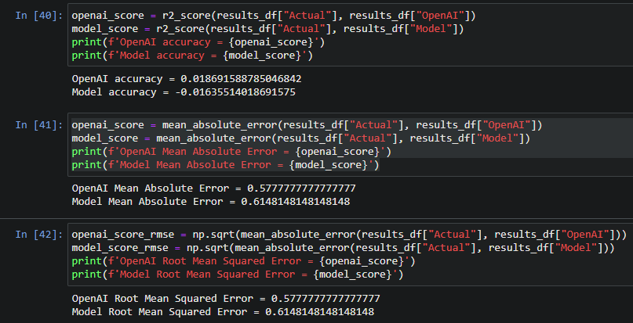
Experiment results using a script
Instead of manual experiment, a script was used to run this experiment with 135 rows of test data, also from the same dataset

Slide 10
Discussion
With the small amount of training data, OpenAI predicts the number of bug with better than our trained model
OpenAI had a 0.02 R_Squared, while our model had a -0.02 R_Squared
The data used for testing is randomly selected, but contained a large number of rows (103 rows) having 0 bugs, and this could skew our experiment results
Limitation of our model is largely due to the OpenAI’s API token limit, which limits the amount of data our model can be trained on since we give the same data to our model and OpenAI’s API
Thus, it seems OpenAI can predict the number of software defects better when there is only not a lot of training data

Slide 11
FUTURE Expansion
Using Different Data
Training with different data (metrics), and allowing users to choose what metrics they want to use for defect prediction
Metric Generation Based on Repo
Automate metric generation into the tool, so users can just link a repository to get an estimated number of defects
Detect defects for other phases
Users can submit a project outline, and get estimated number of defects for each phase
Get better results from OpenAI
Fine Tuning OpenAI

Slide 12
SUMMARY
OpenAI performs well in predicting the number of software defects in our given scenario
Further uses can be done for OpenAI to assist in defect prediction in other scenarios

Slide 13
CITATIONS
Sayyad Shirabad, J. and Menzies, T.J. (2005) The PROMISE Repository of Software Engineering Databases. School of Information Technology and Engineering, University of Ottawa, Canada . Available: http://promise.site.uottawa.ca/SERepository
Tunnell, James W., "Using Time Series Models for Defect Prediction in Software Release Planning" (2015). All Master's Theses. 144.

